Slide 1

Getting Started on Mac OSX

Slide 2
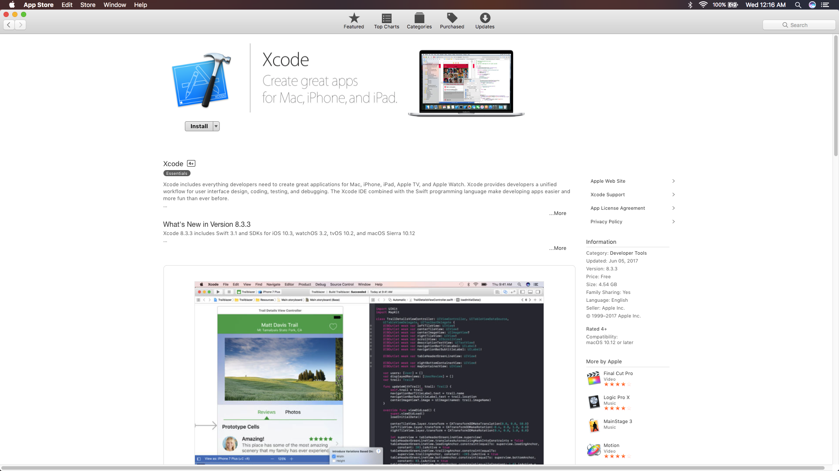
Install Xcode from the App Store.

Slide 3
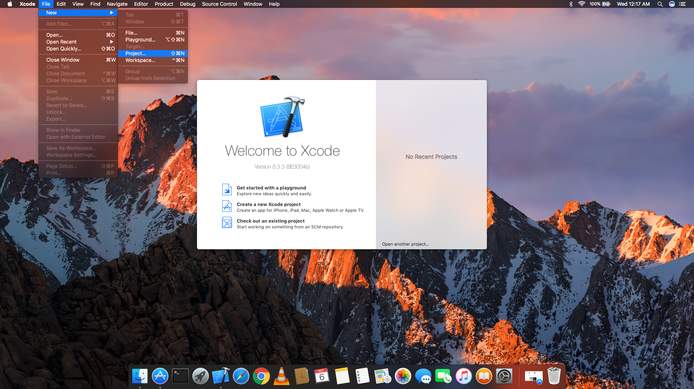
In Xcode create a new project.

Slide 4
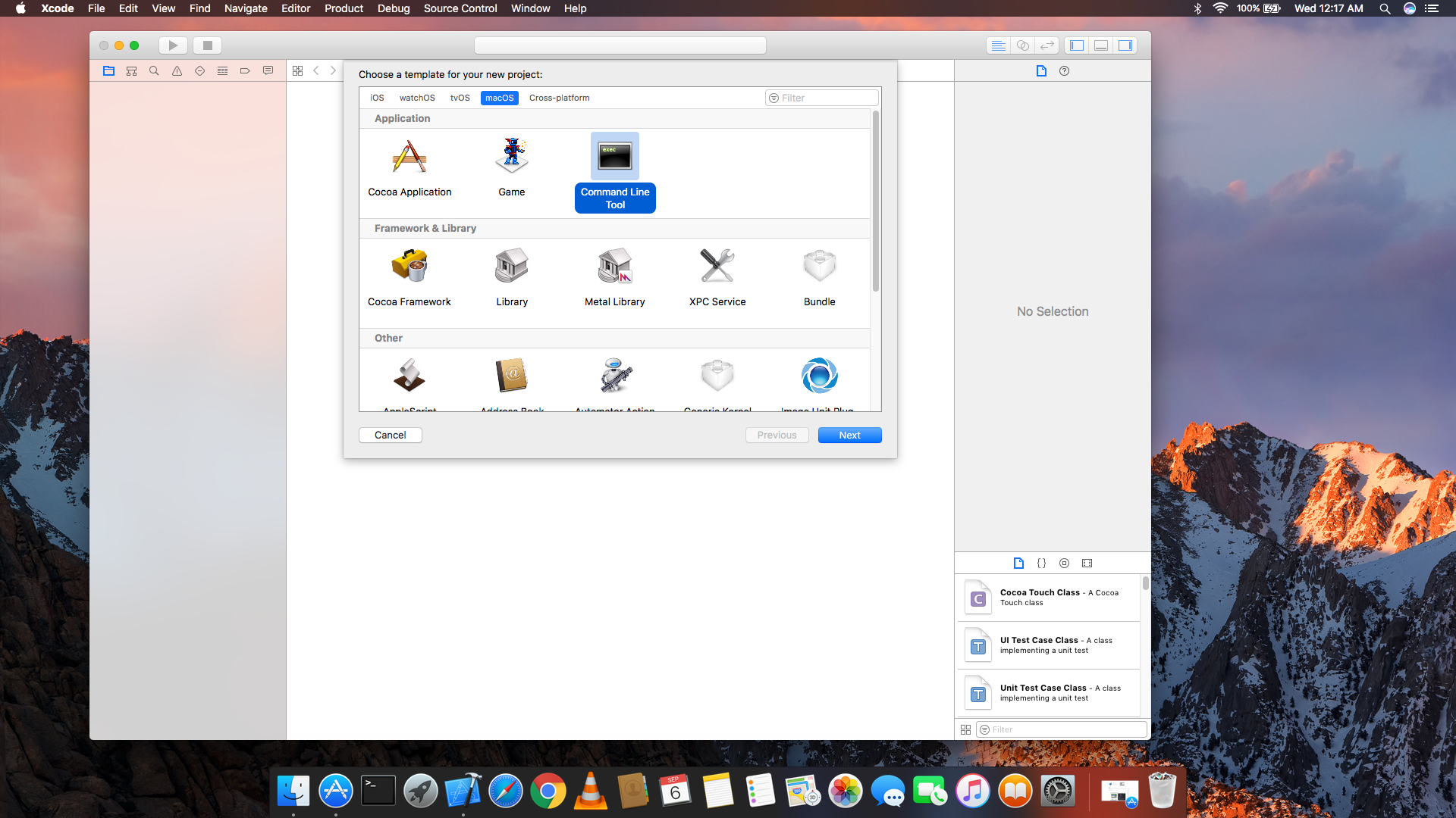
Select macOS then select Command line Tool

Slide 5
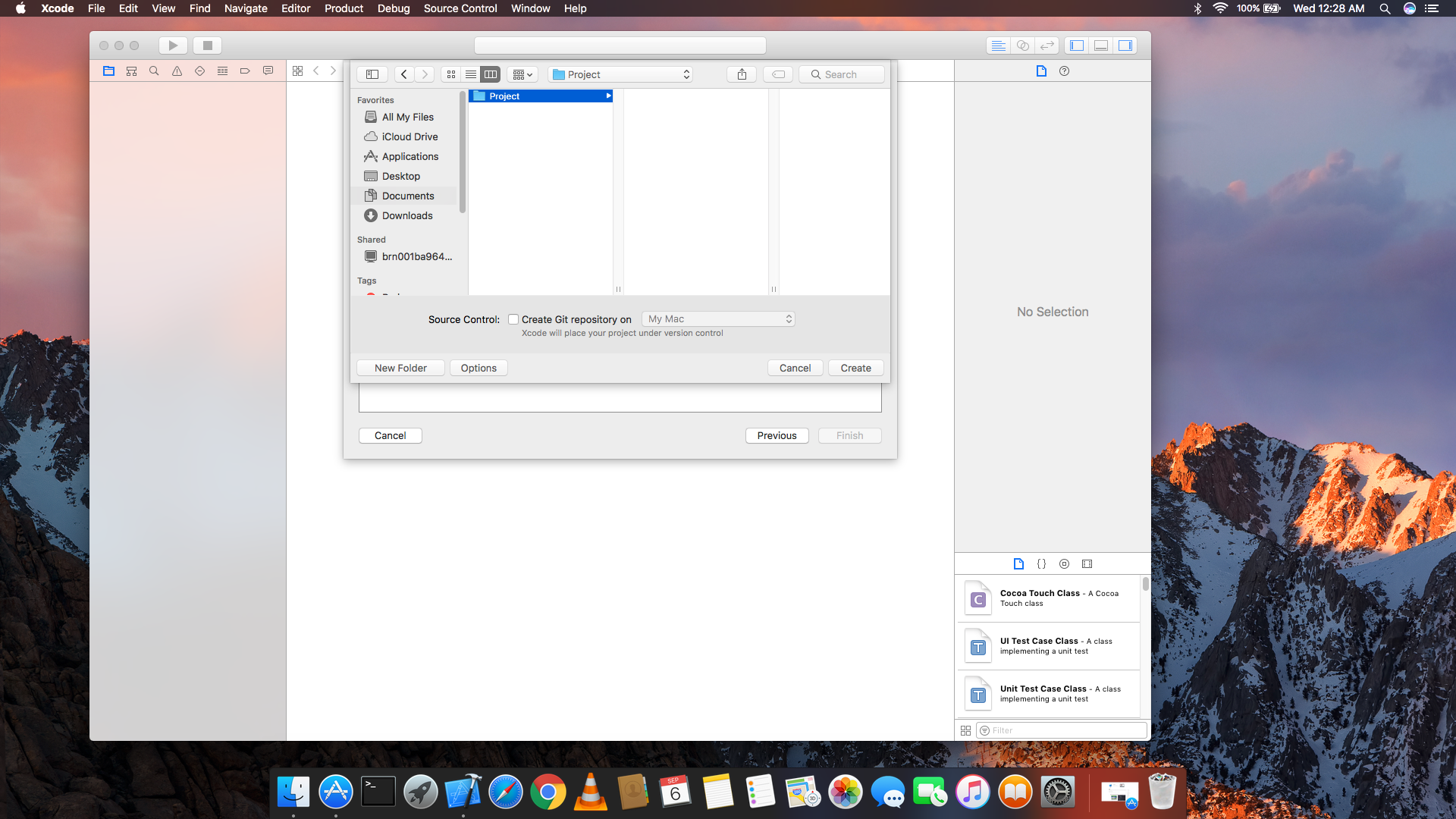
Figure out which directory you want to save your C++ Project.

Slide 6
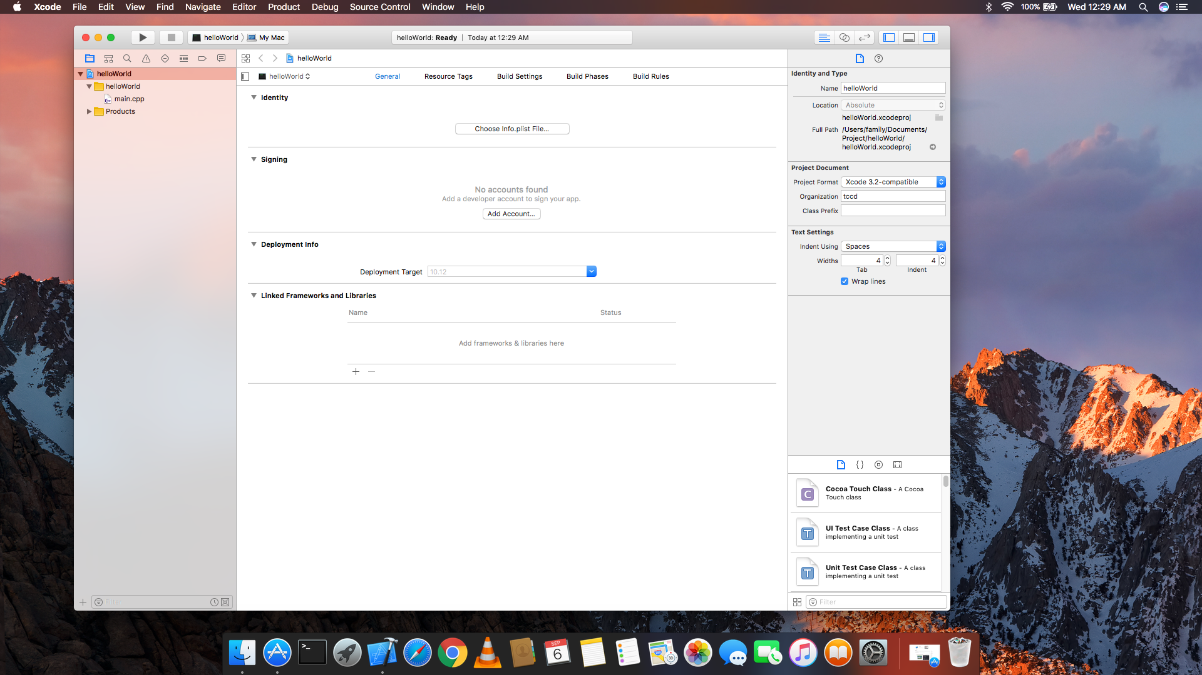
You should see an main.cpp file. Double click the file.

Slide 7
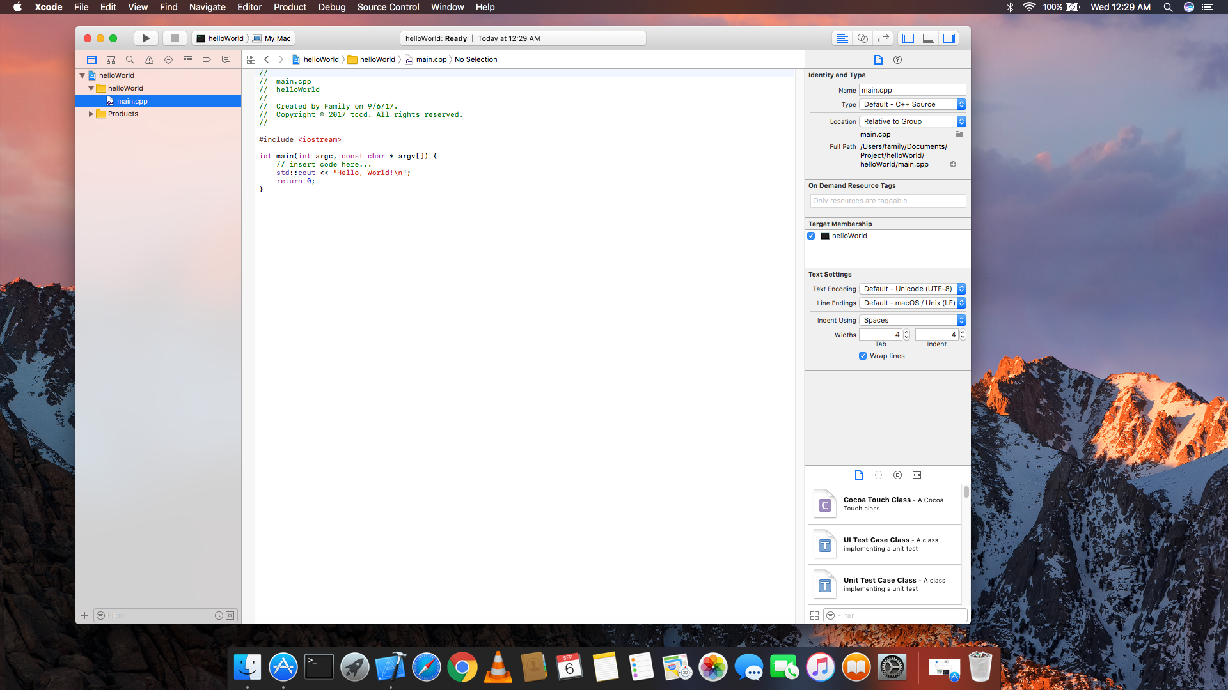
This is what you should see.
*All through out this setup process the Operating system will ask you for permission by asking for your password. Please remember to accept those requests.

Slide 8
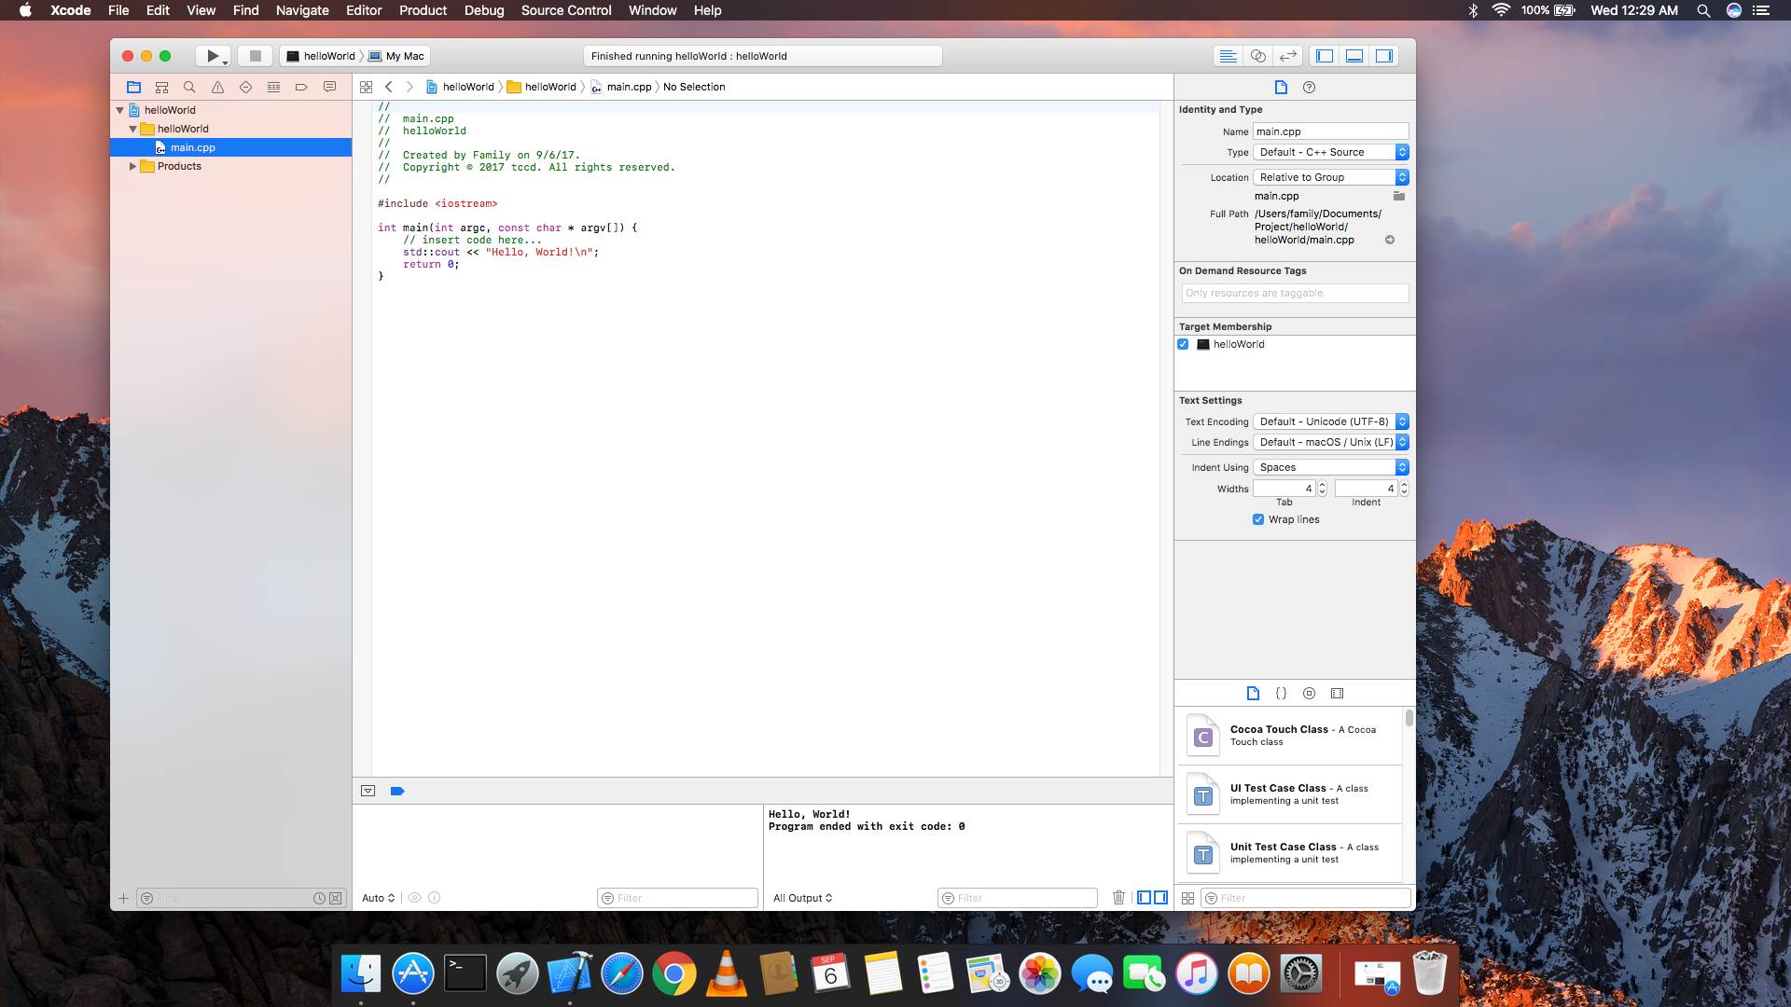
Press the play button to compile your code.
The results or errors will show up here.

